Slide 1
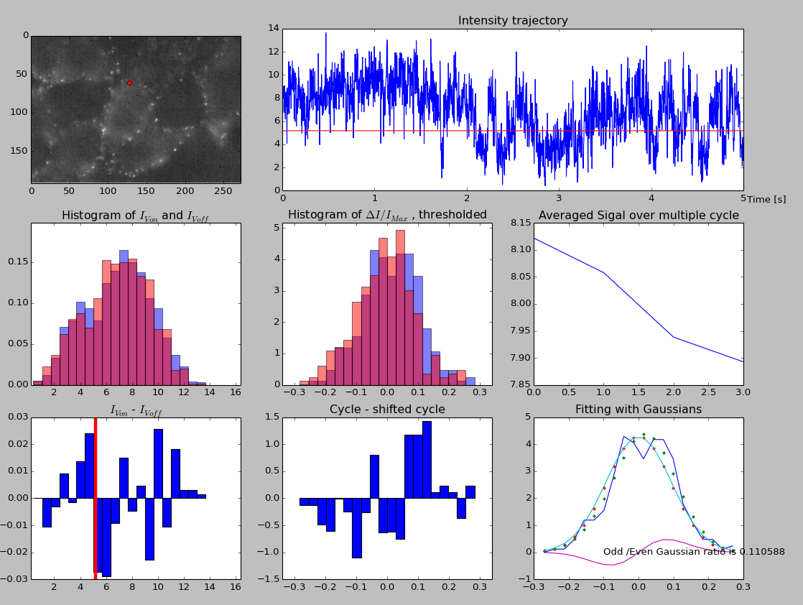

Slide 2
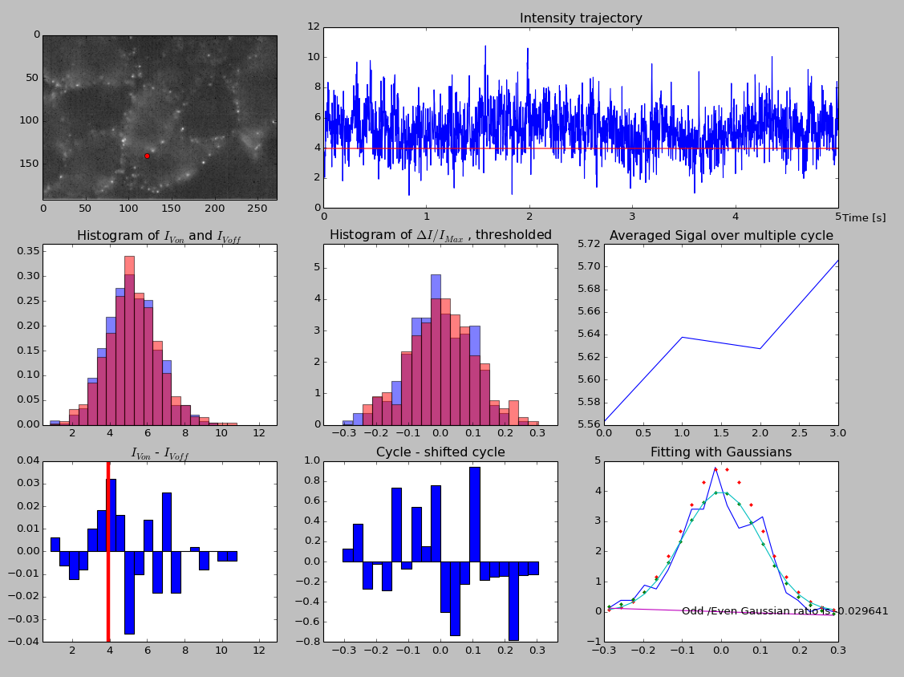

Slide 3
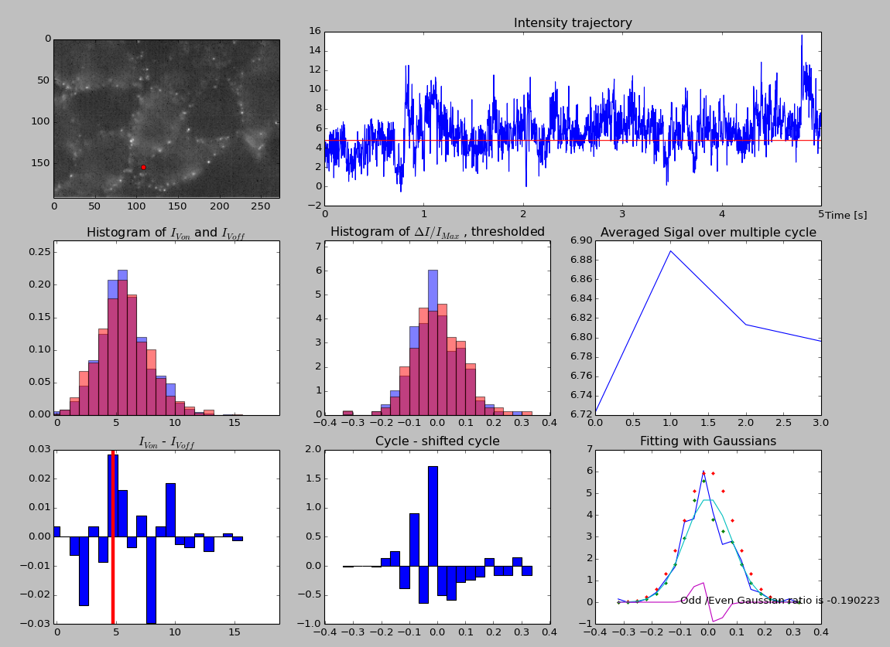

Slide 4
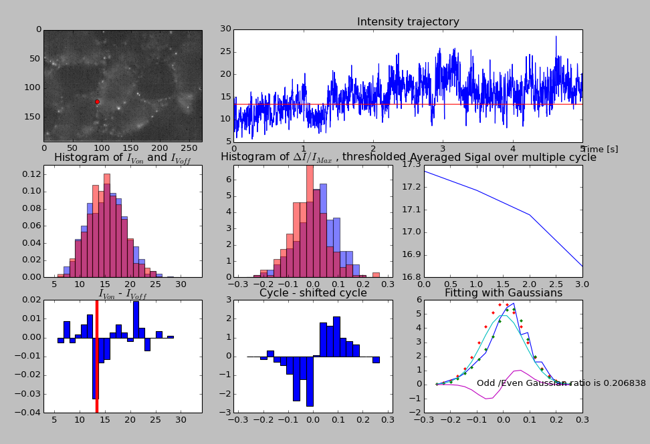

Slide 5
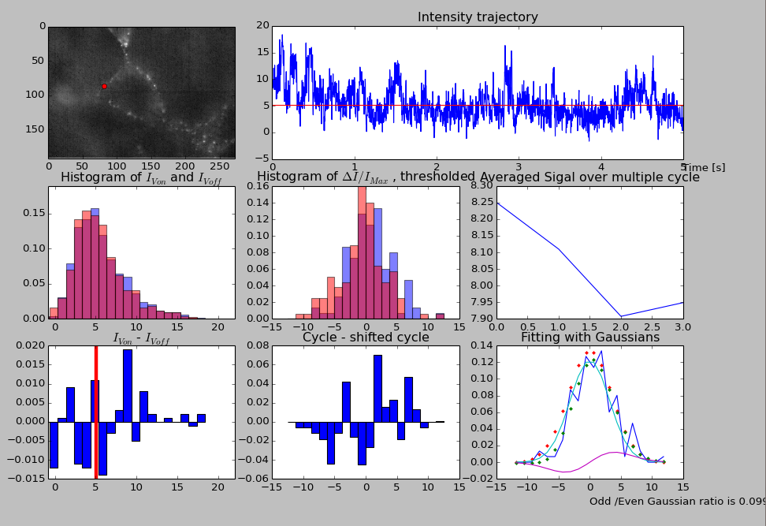
One of the best data, showing ~3% ΔF/F

Slide 6
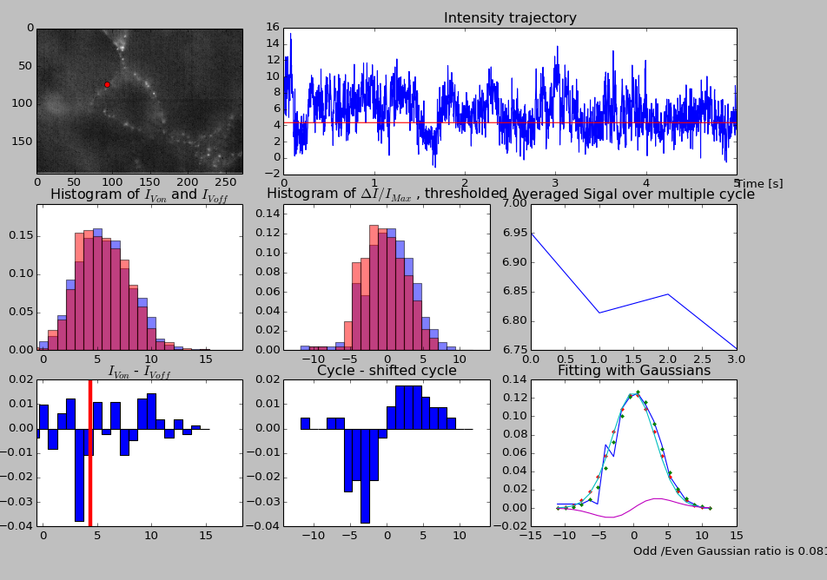

Slide 7
Patched cell's dF/F |  |  |  |  |  | absolute
Folder name | 122126 | 122055 | 122018 | 114640 |  | 122126 | 122055 | 122018 | 114640
 | 7.87E-03 | 5.05E-03 | 1.71E-02 | -2.61E-02 |  | 0.007868 | 0.005051 | 0.017124 | 0.026089
 | 5.86E-03 | -1.02E-03 | -1.12E-02 | -4.76E-03 |  | 0.005857 | 0.001017 | 0.011157 | 0.004762
 | -1.16E-02 | -3.30E-03 | -8.94E-03 | 8.56E-04 |  | 0.011624 | 0.003297 | 0.008941 | 0.000856
 | -3.86E-03 | 2.13E-03 | -1.02E-02 | 2.40E-03 |  | 0.003861 | 0.002131 | 0.010227 | 0.002398
 | 3.01E-04 | 2.09E-02 | -1.07E-02 | -1.20E-02 |  | 0.000301 | 0.020881 | 0.010652 | 0.011981
 | 5.64E-03 | -1.35E-02 | -3.21E-02 | -1.42E-03 |  | 0.005638 | 0.013516 | 0.032111 | 0.001422
 | 2.98E-03 | 5.24E-03 | 4.33E-03 | -1.56E-02 |  | 0.00298 | 0.005243 | 0.004328 | 0.015609
 | 1.48E-02 | 1.43E-03 | -2.11E-02 | 2.70E-02 |  | 0.014801 | 0.001426 | 0.021149 | 0.026965
 | 7.98E-03 |  | 3.95E-03 | 3.24E-02 |  | 0.007983 |  | 0.003953 | 0.032352
 | 5.30E-03 |  |  | 1.82E-02 |  | 0.005301 |  |  | 0.01823
 | 1.64E-02 |  |  | 3.99E-03 |  | 0.016411 |  |  | 0.003986
 | 1.70E-02 |  |  | 1.75E-02 |  | 0.016951 |  |  | 0.017522
 | -2.14E-03 |  |  | -6.73E-03 |  | 0.002145 |  |  | 0.006729
 | 5.45E-03 |  |  | -6.73E-03 |  | 0.00545 |  |  | 0.006729
 | -1.28E-02 |  |  | 1.84E-02 |  | 0.01281 |  |  | 0.018401
 |  |  |  | -1.73E-02 |  |  |  |  | 0.017304
 |  |  |  | -3.41E-02 |  |  |  |  | 0.034058
 |  |  |  | 1.24E-02 |  |  |  |  | 0.012377
 |  |  |  | 4.24E-03 |  |  |  |  | 0.004239
 |  |  |  | -1.14E-02 |  |  |  |  | 0.011354
 |  |  |  | 3.26E-03 |  |  |  |  | 0.003259
Range: -3.4% ~ 3.2%
Absolute Average: 1.1%

Slide 8
Not patched |  |  |  |  |  | absolute
Folder name | 122126 | 122055 | 122018 | 114640 |  | 122126 | 122055 | 122018 | 114640
 | 5.80E-03 | -2.11E-02 | -1.60E-03 | -1.11E-02 |  | 0.0058 | 0.021138 | 0.001598 | 0.011051
 | 7.03E-03 | 1.07E-02 | -9.97E-03 | 6.75E-03 |  | 0.007034 | 0.010704 | 0.009971 | 0.006754
 | -7.55E-03 | -3.60E-03 | -1.87E-03 | -1.91E-02 |  | 0.007546 | 0.003601 | 0.001871 | 0.019054
 | 3.68E-03 | 8.81E-05 | 3.72E-03 | -4.27E-03 |  | 0.003684 | 8.81E-05 | 0.003724 | 0.004273
 | -6.59E-03 | 1.28E-02 | -1.90E-02 | 1.69E-03 |  | 0.006587 | 0.012826 | 0.018966 | 0.001695
 | 4.12E-03 | 2.47E-03 | -9.41E-03 | 8.25E-03 |  | 0.004122 | 0.00247 | 0.009411 | 0.008248
 | -1.18E-02 | 1.72E-02 | -1.28E-02 | -8.15E-04 |  | 0.01184 | 0.017179 | 0.012845 | 0.000815
 | 6.05E-03 |  | -8.54E-03 | 1.93E-02 |  | 0.006052 |  | 0.008539 | 0.01932
 | 3.48E-03 |  | 1.74E-03 | -2.39E-02 |  | 0.003477 |  | 0.001737 | 0.023935
 | 7.49E-03 |  | -1.49E-02 | 4.76E-04 |  | 0.007487 |  | 0.014891 | 0.000476
 | -3.86E-03 |  | -6.22E-03 | -2.33E-02 |  | 0.003857 |  | 0.006222 | 0.023279
 | -1.39E-03 |  |  |  |  | 0.001387
 | -1.58E-03 |  |  |  |  | 0.001577
Range: -2.4% ~ 1.9%
Absolute Average: 0.8%

